Slide 1
Create Model Classes
Introduction to JPA & Hibernate
Create a Model Class Manually
Generate Model Classes using Hibernate Reverse Engineering Tool
Model Classes: Users, Category, Book, Customer, Review, BookOrder and OrderDetail

Slide 2
Java Persistence API (JPA)
JPA is a Java API specification for relational data management in applications using Java SE and Java EE.
Version used: JPA 2.1
API Package:
javax.persistence
Java Persistence Query Language (JPQL)
Implementations: Hibernate, EclipseLink, OpenJPA…

Slide 3
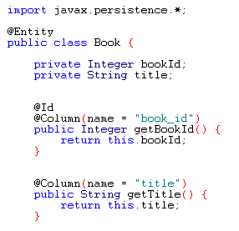
JPA Examples
Query:
SELECT b FROM Book b ORDER BY b.title

Slide 4
Hibernate Framework
Hibernate is a Object-Relational Mapping Framework
Hibernate is an implementation (or provider) of JPA
Hibernate ORM: Core
Domain model persistence for relational databases
Hibernate Search:
full-text search for domain model
Hibernate Validator:
constraints for domain model
Hibernate OGM:
domain model persistence for NoSQL databases
Hibernate Tools:
Plugins for Eclipse: Mapping Editor, Console, Reverse Engineering, …

Slide 5
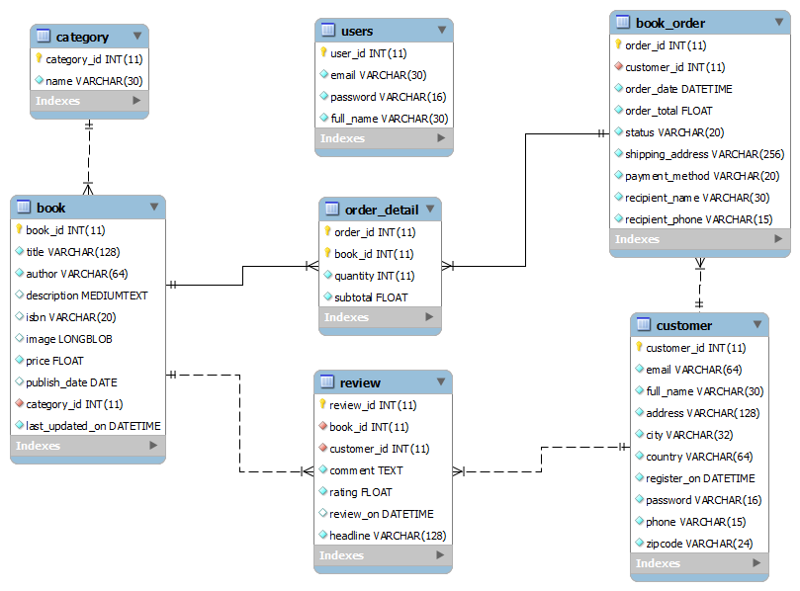
Entity Relationship Diagram

Slide 6
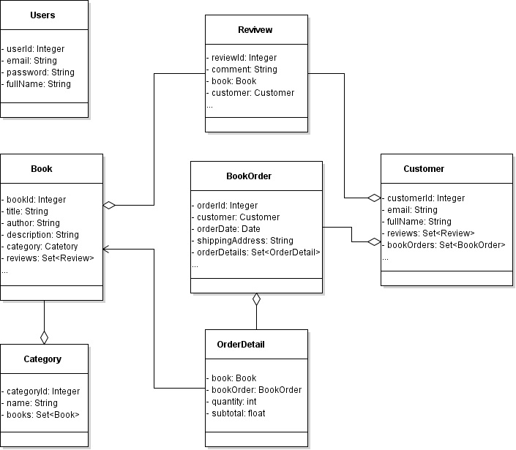
Model Class Diagram

Slide 7
Create a Model Class Manually
Create a POJO class: Users.java
Using Annotations
Create JPA Config File: persistence.xml
Code a Test Program

Slide 8
JPA’s Annotations
@Entity
@Table
@Column
@Id
@GeneratedValue

Slide 9
JPA’s Configuration File
Persistence Unit Name: BookstoreWebiste
Database Connection Properties:
JDBC URL
User
Password
JDBC Driver

Slide 10
Code a Test Program
Create an EntityManagerFactory
Create an EntityManager
Begin a transaction
Persist a Users object
Commit the transaction
Close the EntityManager
Close the EntityManagerFactory
Verify Result using MySQL Command Line Client

Slide 11
Generate Model Classes using Hibernate Reverse Engineering Tool
<?xml version="1.0" encoding="UTF-8"?>
<!DOCTYPE hibernate-configuration PUBLIC
"-//Hibernate/Hibernate Configuration DTD 3.0//EN"
"http://www.hibernate.org/dtd/hibernate-configuration-3.0.dtd">
<hibernate-configuration>
<session-factory>
<property name="hibernate.connection.driver_class">com.mysql.jdbc.Driver</property>
<property name="hibernate.connection.password">admin</property>
<property name="hibernate.connection.url">jdbc:mysql://localhost:3306/bookstoredb</property>
<property name="hibernate.connection.username">root</property>
<property name="hibernate.dialect">org.hibernate.dialect.MySQLDialect</property>
</session-factory>
</hibernate-configuration>

